Slide 1
Introduction to Pangolin Ad
Kris Wu
2020/01/30.

Slide 2

Pangolin
What is Pangolin
Why we use Pangolin
How to do
What we have done
…
Next...

Slide 3

Pangolin (Pangle)
穿山甲→ 천산갑 → Pangolin
https://partner.oceanengine.com/
Notes:
https://partner.oceanengine.com/news-detail?id=190

Slide 4
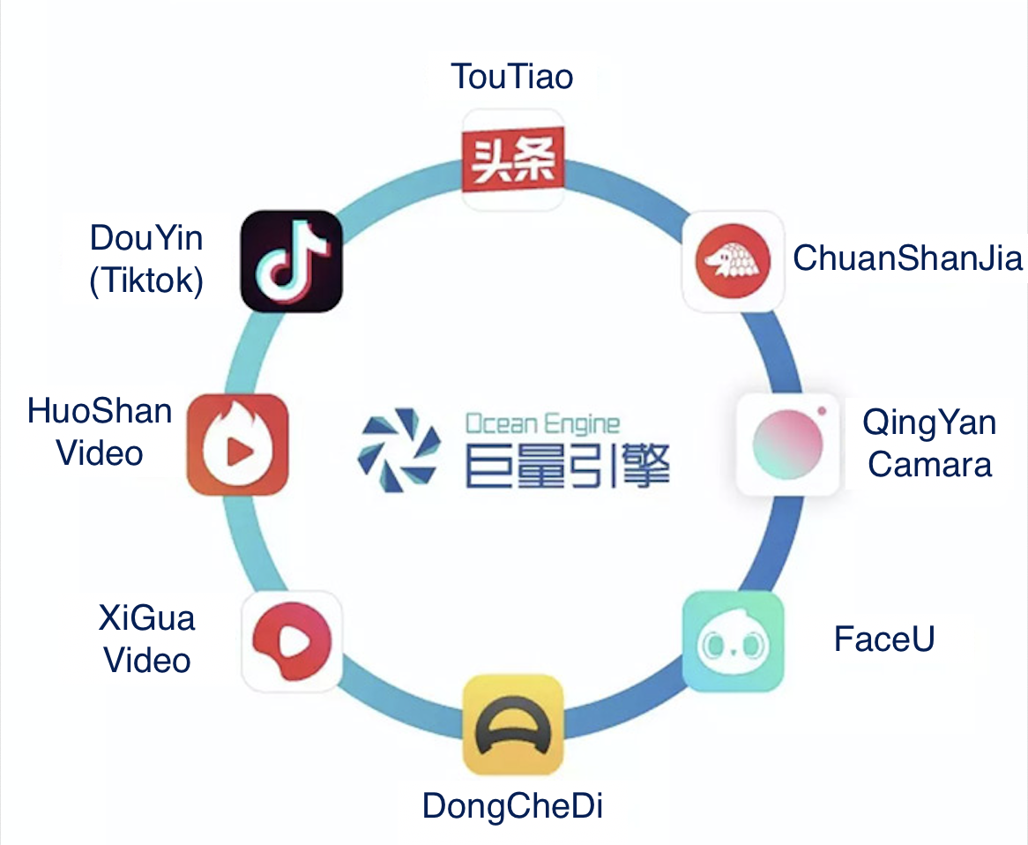
Pangolin
https://partner.oceanengine.com/
One of the products of Ocean Engine. (Released on 2018/08/14)
Ocean Engine is the marketing brand of ByteDance.
Notes:
https://ad.oceanengine.com/pages/index.html
https://www.oceanengine.com/help/118

Slide 5
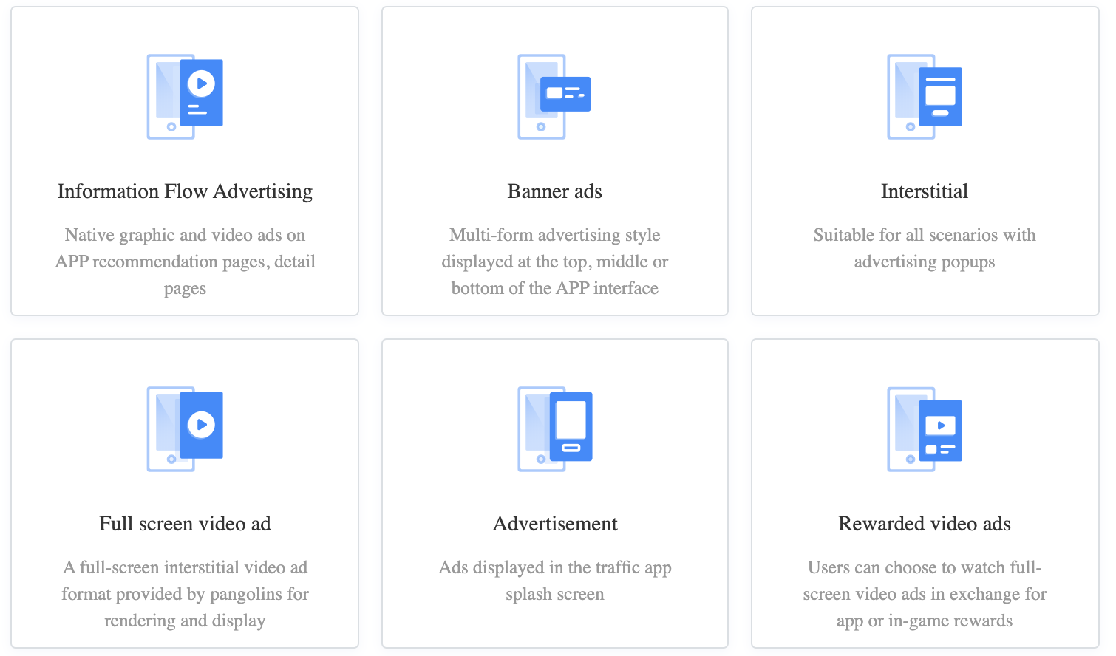
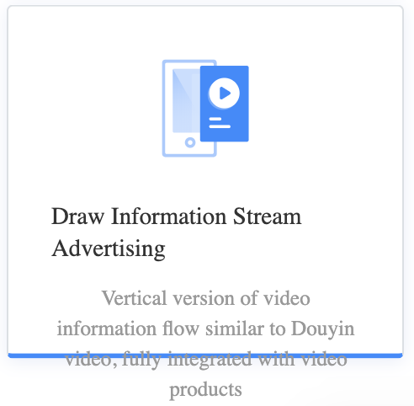
Provided Ad formats
Interstitial Ads
Native Express Ads
Banner Ads
Interstitial Ads
Immersive Video Feed Ads
Interstitial Video Ads
Splash Ads
Rewarded Video Ads
https://partner.oceanengine.com/style
Notes:
https://partner.oceanengine.com/union/media/union/position/create

Slide 6
Why Pangolin?
Tencent has stopped their services.
One of the most popular ad networks used by mobile apps and games in China.
As of December 2019, Pangolin has achieved a coverage of 700 million daily active users with 40.5 billion daily requests and 6.8 billion daily impressions globally.
It localizes the ads to Chinese users better than some of the other services.

Slide 7

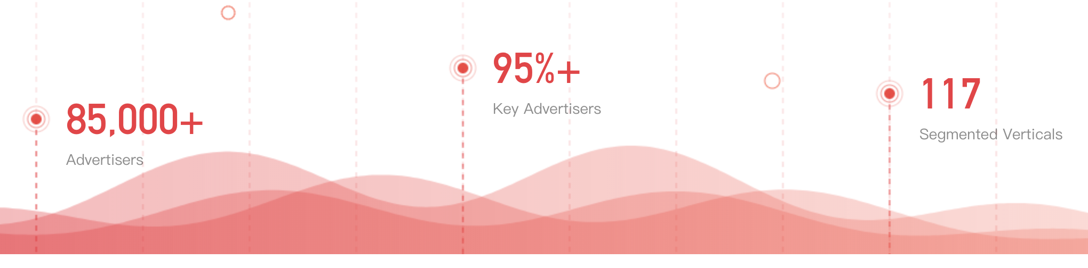

Slide 8
Why Pangolin?
With a strong focus on rewarded video ads which can support our requirement in the future.

Slide 9
Getting Started
Account Registration
& Setup the Billing Info
App & Ad Placement Management
SDK Integration
Currently only a certain company can register the account. For each company, only one account is allowed.
* Pangolin Account:
https://confluence.nexstreaming.com/display/AD1/Pangolin+Account
Create an unique id for App, with required information.
Create an unique id for each Ad. Currently Pangolin provides 7 Ad formats and does not support customized rendering.
Also, some blocking rules can be set for better performances.
Import the package. Setup the global configuration and SDK initialization.
Notes:
https://partner.oceanengine.com/doc?id=5dd366dc61886b0012ed8a4b

Slide 10
Implementation - AdManager & AdProvider
InterstitialAdProvider
AdmobProvider
NativeUnifiedAdProvider
AdManager
FullScreenAdProvider
InteractionExpressAdProvider
PangolinProvider
NativeExpressAdProvider
SplashAdProvider
Notes:
Take a look at the source code

Slide 11
Implementation - Load Pangolin Ad
→ getProvider(Ad_Id) → AddListener(listener) → requestAd()
The provider will
Create an AdSlot to set the configuration
Load the specified Ad (ex. loadSplashAd() )
Notify the listener that the Ad has been loaded
Notes:
Take a look at the source code

Slide 12
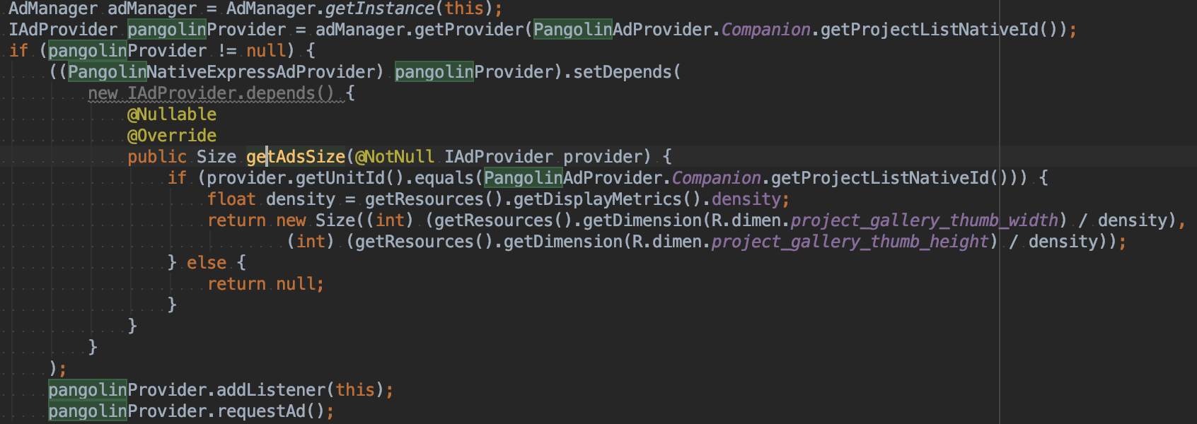
Implementation - AdsSize
Except for full-screen Ads (i.e. Splash Ad, Full-screen Video Ads), AdsSize has to be set before requesting Ads.

Slide 13
Implementation - Implement IAdProvider.Listener
IAdProvider.Listener
override fun onLoaded(provider: IAdProvider, ad: Any?) { val adView: View? = ad.adView addView(adView) }

Slide 14
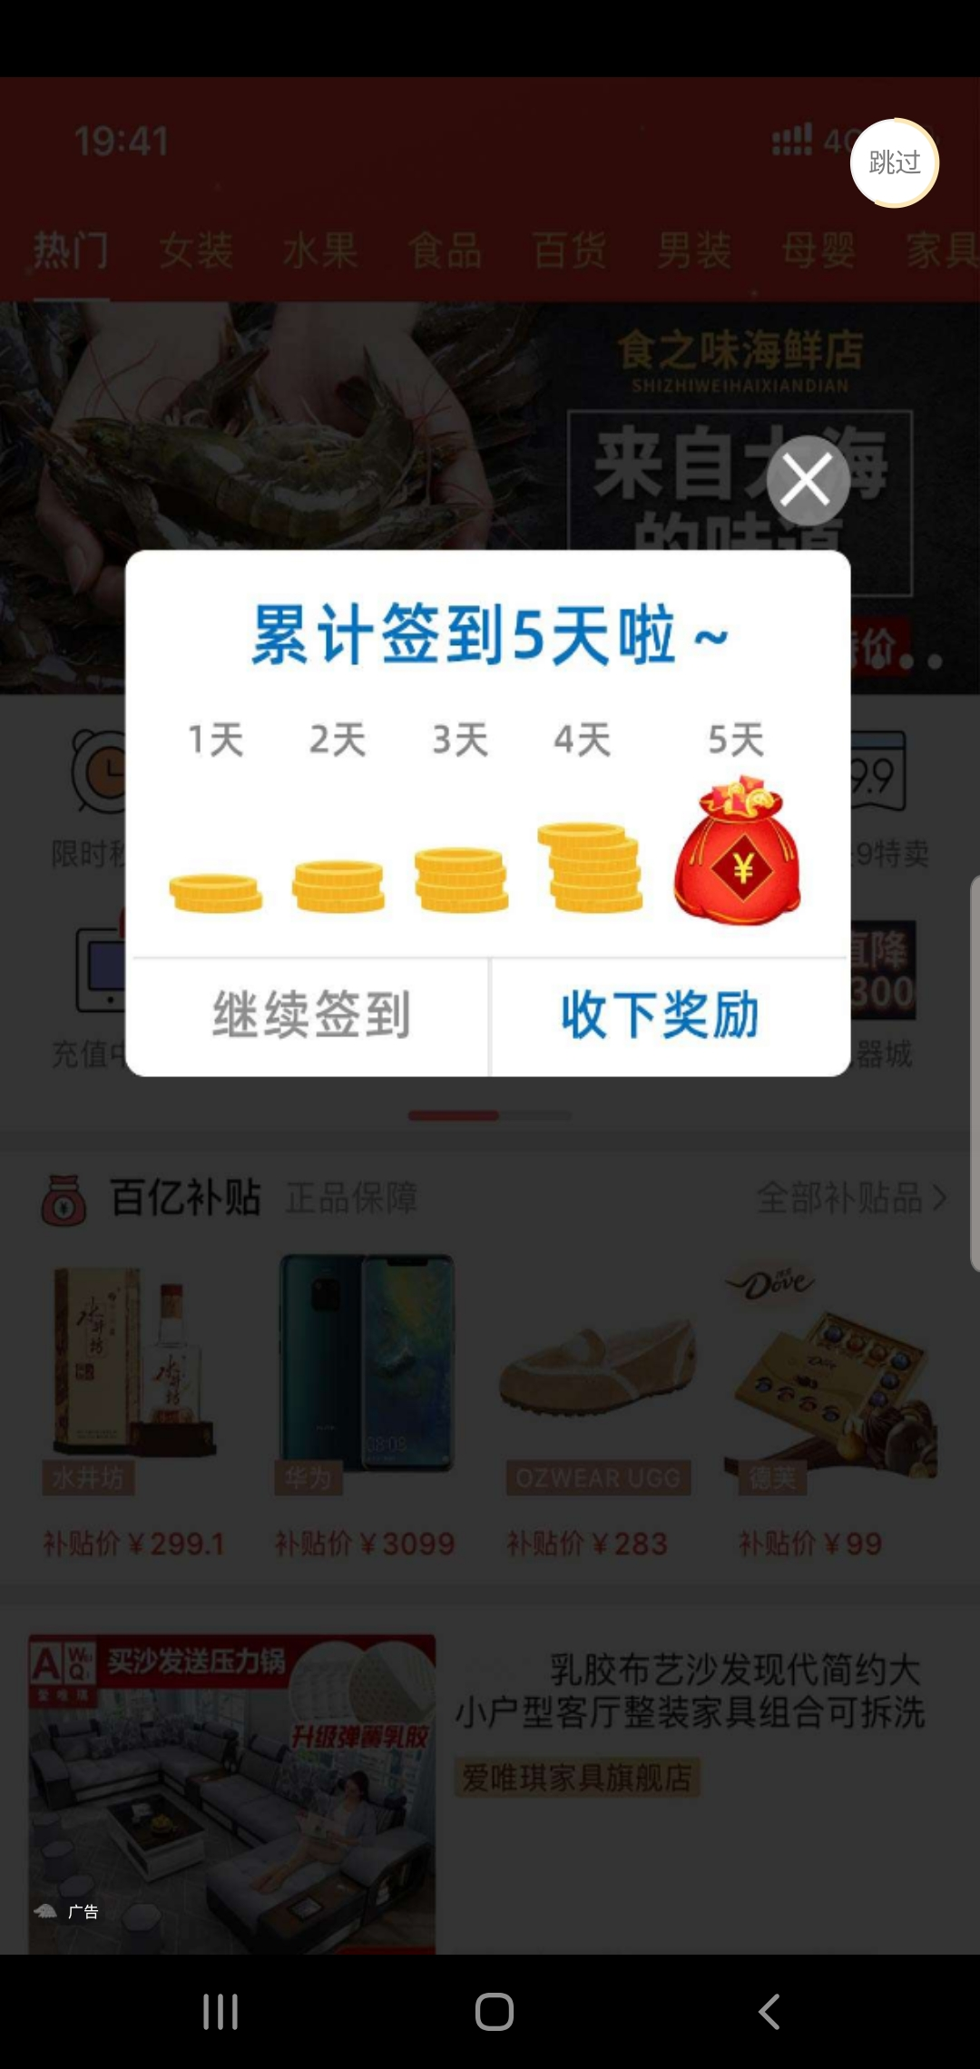
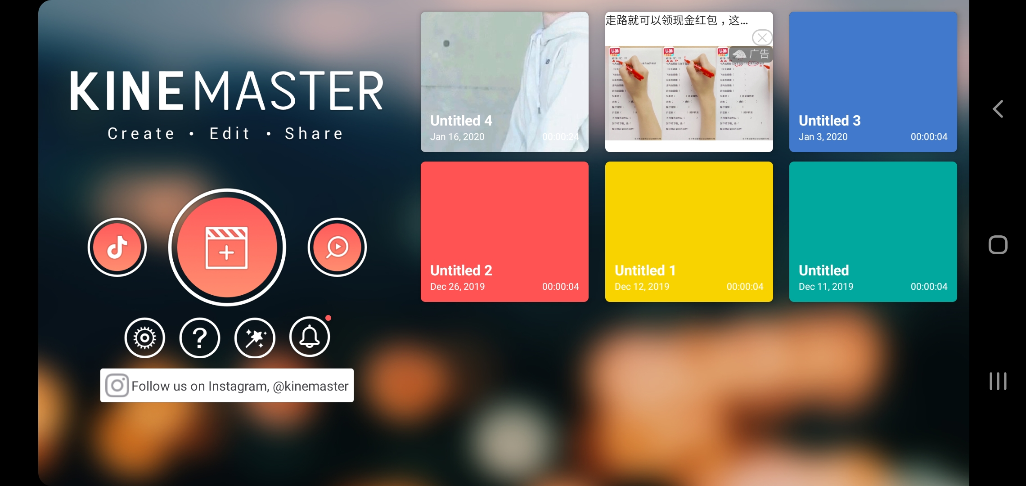
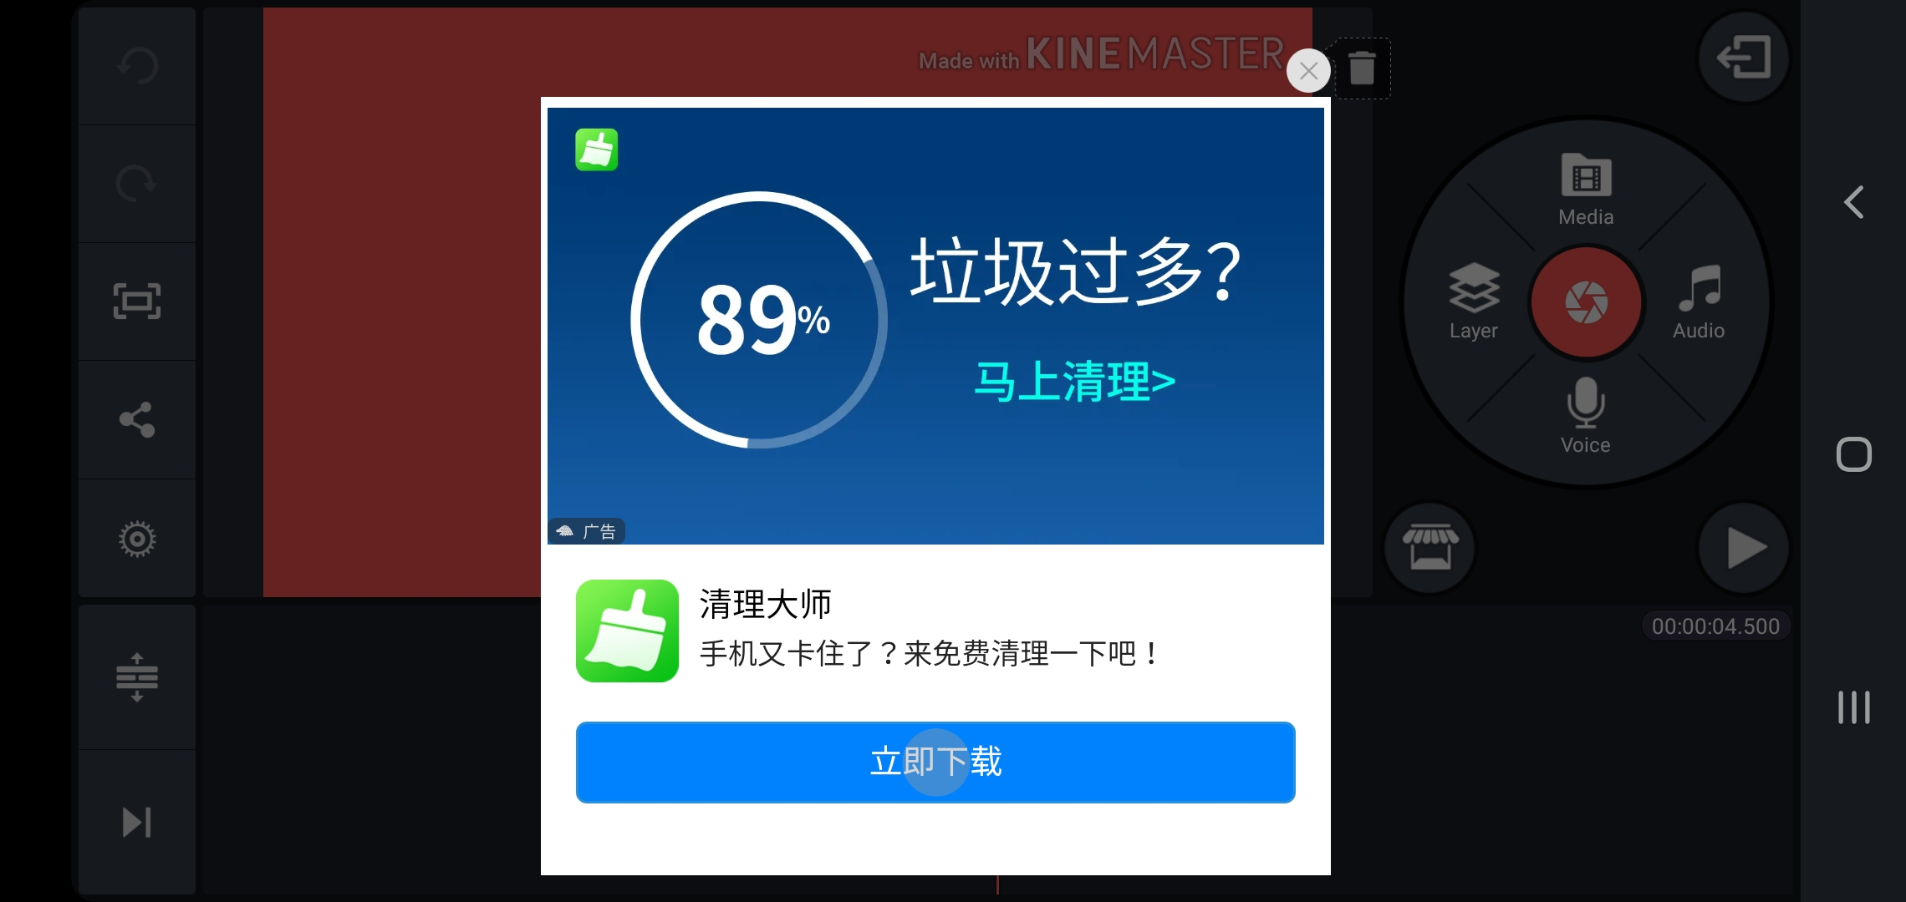
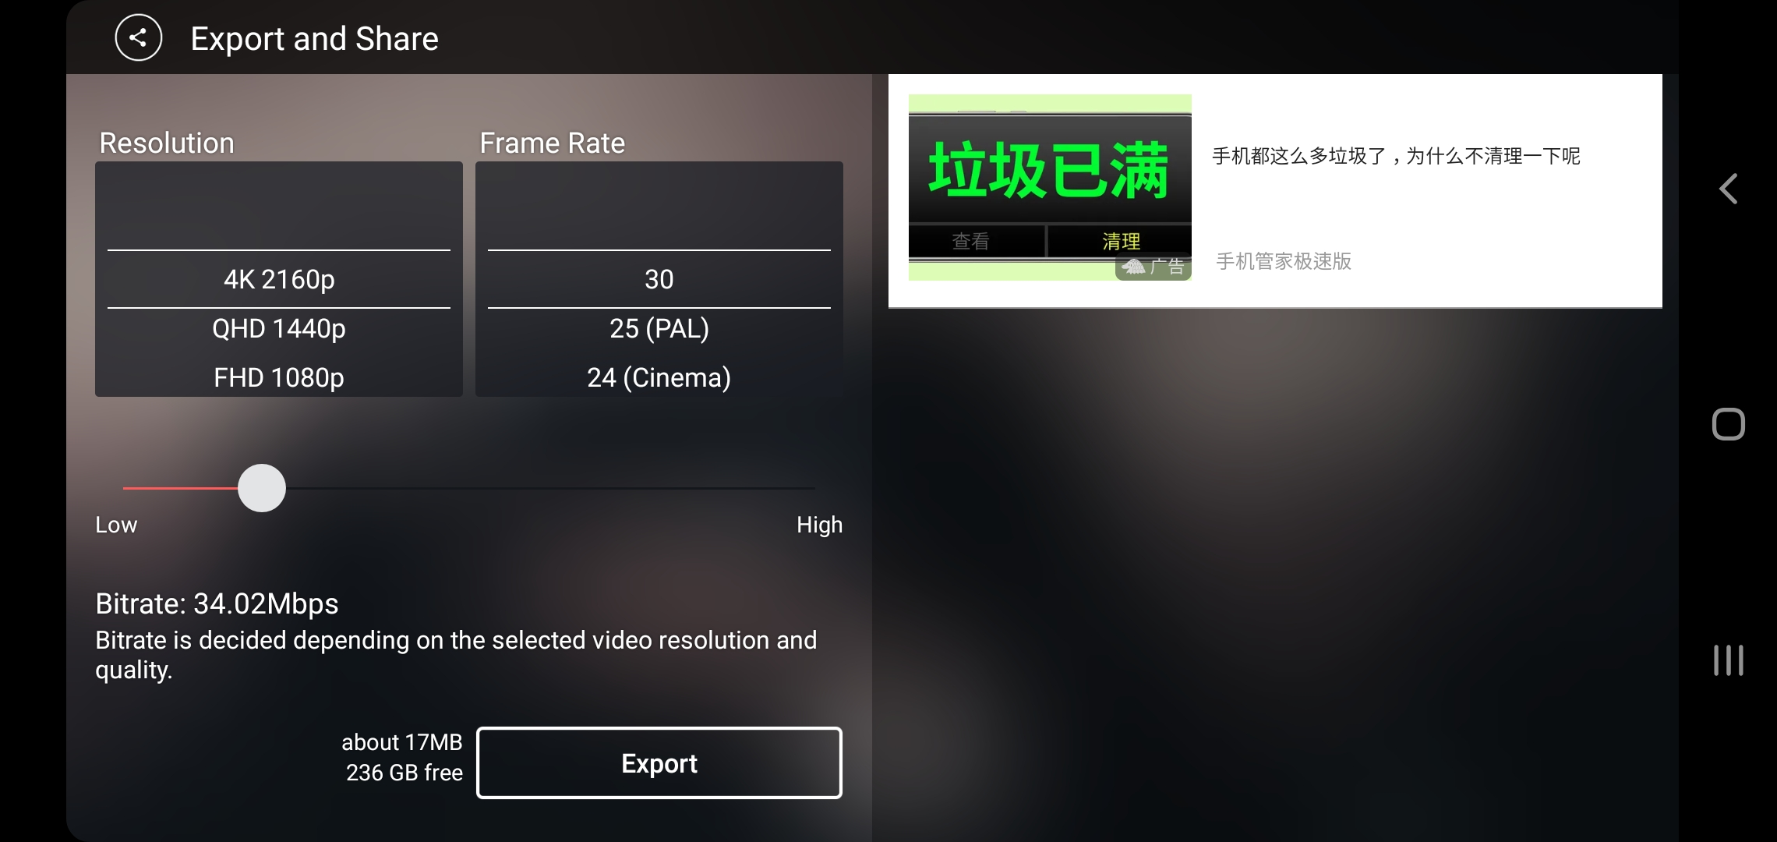
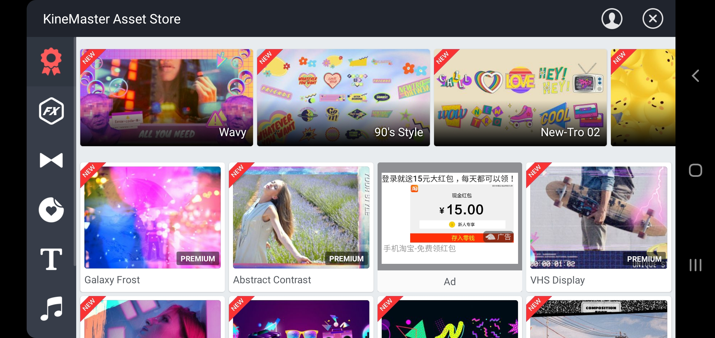
Project Gallery (Native)
Splash
Timeline (Interaction)
Asset Store (Native)
Export & Share
(Native)
Notes:
Console: https://partner.oceanengine.com/union/media/union/report/code

Slide 15
Next…?
Bug Fixing
Refactoring
Rewarded Video Ad
…
...

Slide 16
Thank you.

